Slide 1
Medium access control sublayer

Slide 2
Media Access Control
Medium Access Control (MAC) is a sublayer of the Data-link layer.
The protocols used to determine who goes next on a multi-access channel belongs to a MAC sublayer.
MAC is important in LAN which use a multi-access channel as the basis for communication.

Slide 3
The Channel Allocation Problem
There are two schemes to allocate a single channel among competing users:
1) Static allocation in LANs & MANs.
2) Dynamic Channel Allocation in LANs & MANs

Slide 4
2.1.1 Static channel Allocation in LANs and WANs
Traditional way of allocating a single channel, such as a telephone trunk, among multiple competing users is to chop its capacity by using one of the multiplexing scheme such as FDM, TDM etc.
FDM
If there are N users, the bandwidth is divided into N equal sixed portions, with each other being assigned one portion.
Since each user has a private frequency band, there is no interference among users.
A wireless example is FM radio stations. Each station gets a portion of the FM band and uses it most of the time to broadcast its signal
Problems with FDM: when some users are quiet, their bandwidth is simply lost. They are not using it and no one else is allowed to use it either.
A static allocation is a poor fit to most computer systems, in which data traffic is extremely busty, often with peak traffic ratios of 1000:1. Consequently most of the channel will be idle most of the time.

Slide 5
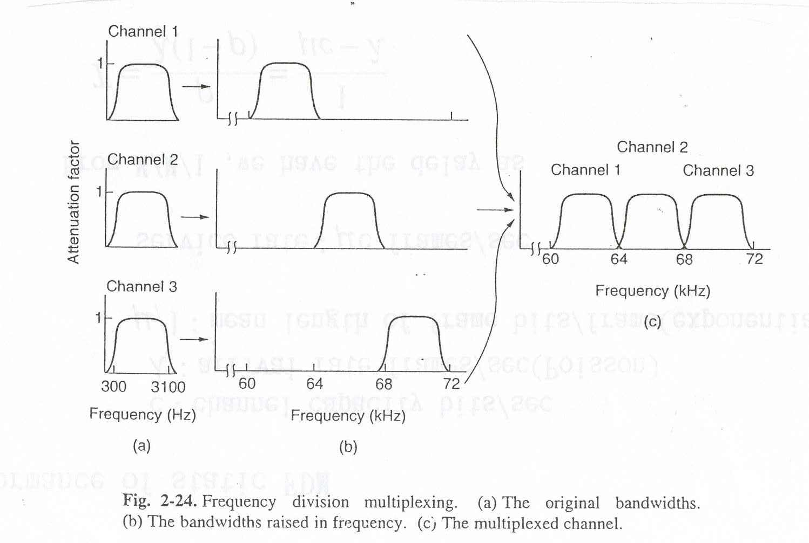
2.1.1 Static channel Allocation in LANs and WANs
Frequency Division Multiplexing (FDM)

Slide 6
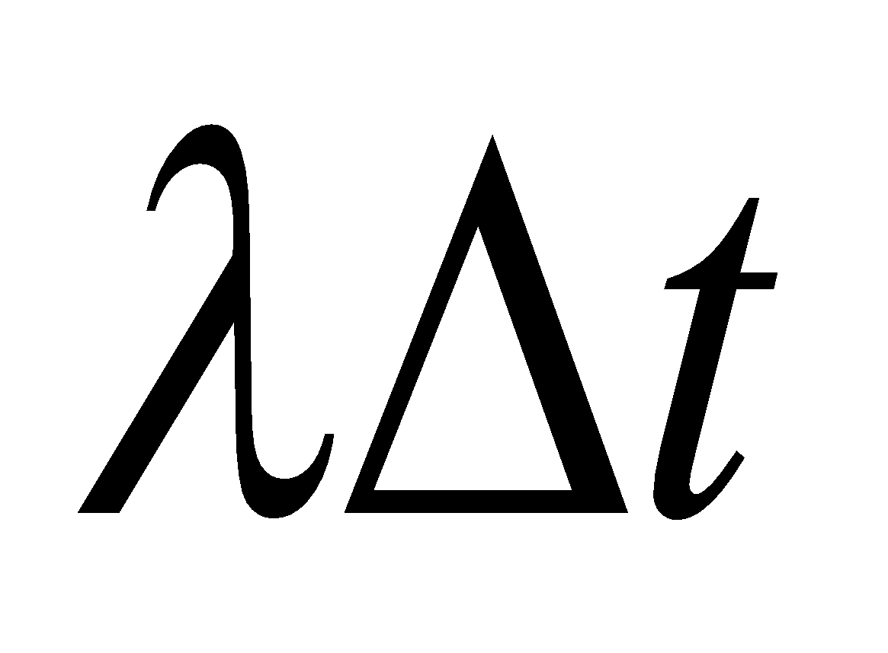
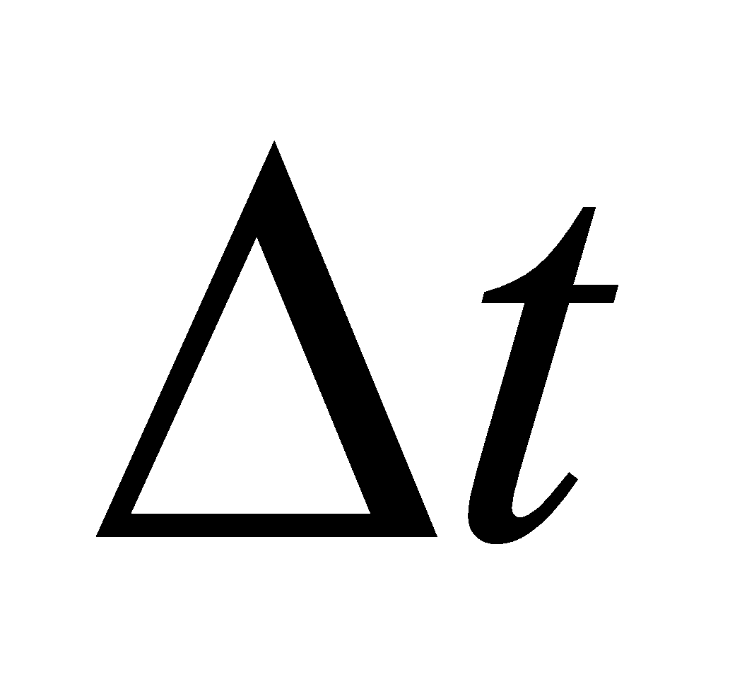

2.1.2 Dynamic Channel Allocation in LANs and WANs
Assumptions
Independent Traffic of Station Model: The model consists of N independent stations, each generates the frame with probability in an interval . Once a frame is generated, the station is blocked.
Single Channel Assumption: A single channel is available for all communication.
Collision Assumption: If two frames are transmitted simultaneously, they overlap in time and resulting signal is garbled. This event is called a Collision. All stations can detect that a collision has occurred. A collided frame must be transmitted again later. No errors other than those generated by collision occur.

Slide 7
2.1.2 Dynamic Channel Allocation in LANs and WANs
Assumptions
4. Continuous or slotted time:
4a. Continuous Time: time may be assumed continuous in which case, Frame transmission can begin at any instant.
4b. Slotted Time: Time is divided into discrete intervals called as slots. Frame transmission always begin at the start of a slot. A slot may contain 0 (idle slot) or 1 (successful transmission) or more frames (collision).
5. Carrier Sense or Non carrier sense:
5a. Carrier Sense. Stations can tell if the channel is in use before trying to use it.
No station will attempt to use the channel while it is sensed as busy.
5b. No Carrier Sense. Stations cannot sense the channel before trying to use it. They just go ahead and transmit. Only later can they determine whether transmission was successful.

Slide 8
MULTIPLE ACCESS PROTOCOLS
ALOHA, CSMA, CSMA/CD

Slide 9
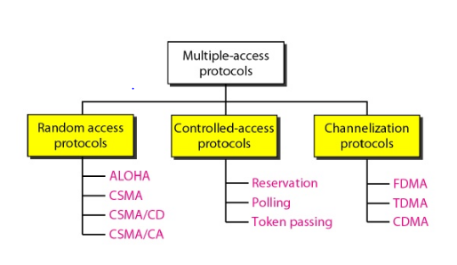
MULTIPLE ACCESS PROTOCOLS -CLASSIFICATION

Slide 10
2.2.1 ALOHA
ALOHA is a system proposed for solving the channel allocation problem.
there are two versions of ALOHA:
Pure ALOHA
Slotted ALOHA
The basic difference with respect to timing is:
Pure ALOHA does not require global time synchronization; i.e. time is continuous
In slotted ALOHA time is divided into discrete slots

Slide 11
Pure ALOHA
The system is working as follows:
let users transmit whenever they have data to be sent.
expected collisions will occur.
the collided frames will be destroyed.
using a feedback mechanism to know about the status of frame.
retransmit the destroyed frame

Slide 12
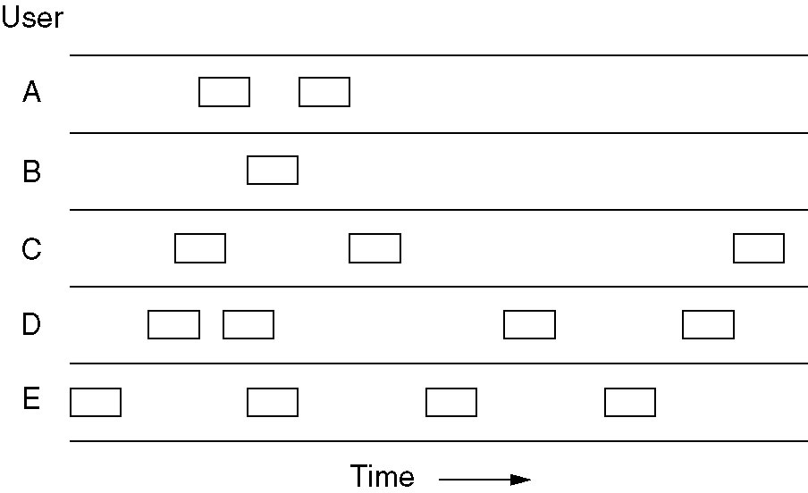
Pure ALOHA
Fig 2.2.1a frames are transmitted at completely arbitrary times.

Slide 13
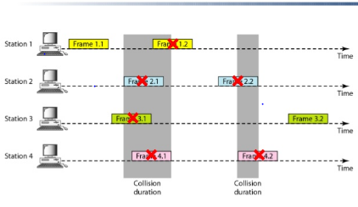
Pure ALOHA
Fig 2.2.1b frames are transmitted at completely arbitrary times.

Slide 14
Pure ALOHA
Such systems where multiple users share a common channel in a way that leads to conflicts are known as ‘contention systems’
As seen in Fig. 4.2.1a and b, whenever two frames try to occupy the channel at the same time, collision occurs and both frames are garbled.

Slide 15
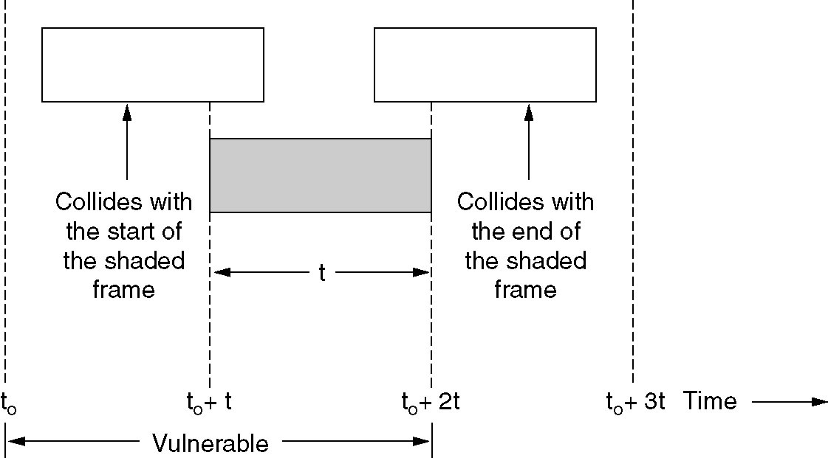
Pure ALOHA - Vulnerable time for collision
Fig. 2.2.2 Vulnerable period for the shaded frame.

Slide 16
Pure ALOHA - Throughput
Assume k frames are generated within a frame time and G frames are expected by the channel. The probability of this is given as:
Pr[k] = G^{k} e^{-G}/k!
Thus, probability of 0 frames is: e^{-G}

Slide 17
Pure ALOHA - Throughput
In an interval of two frame times, number of frames generated becomes 2G
Thus, Throughput per frame time, S is given as:
S = G e^{-2G}
In an interval of two frame times, number of frames generated becomes 2G
As seen in Fig. 4.2.3, throughput is maximum at G = 0.5 and S = 0.184

Slide 18
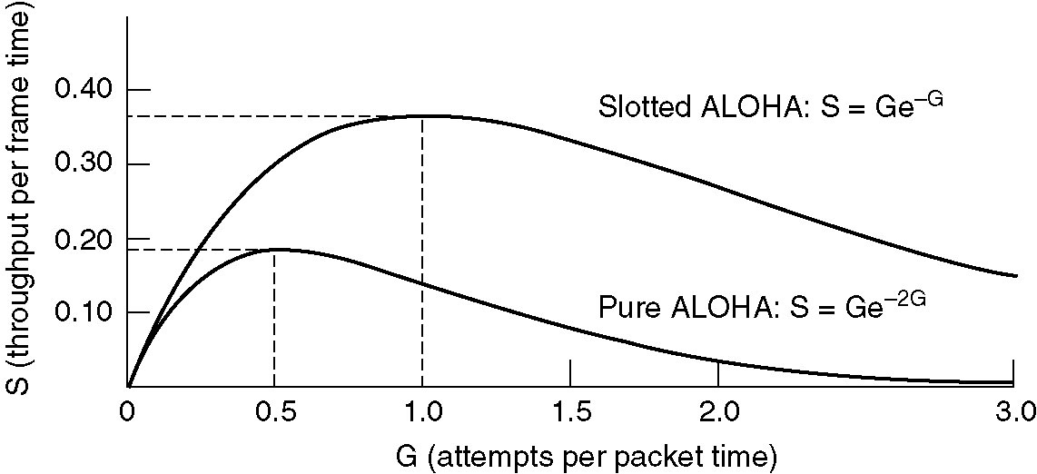
Pure ALOHA - Throughput
Fig. 4.2.3 Throughput versus offered traffic for ALOHA systems.

Slide 19
Pure ALOHA - Disadvantages
The main disadvantage of Pure ALOHA is a low channel utilization.
This is expected due to the feature that all users transmit whenever they want.

Slide 20
Slotted ALOHA
Time is divided into discrete intervals; each interval corresponding to one frame
Stations can only transmit frames at the beginning of the slot
Hence, synchronization is needed, for which a ‘pip’ is emitted at the start of each interval like a clock
Vulnerable period is halved as a station has to wait for its slot to begin.

Slide 21
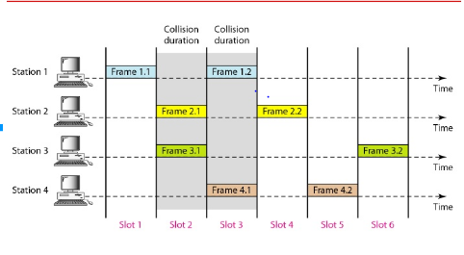
Slotted ALOHA

Slide 22
Slotted ALOHA - Throughput
The probability that no other traffic is present during same slot as our frame; i.e collision is avoided is e^{-G}
Thus, throughput per frame time is given as:
S = G e^{-G}
As seen in Fig. 4.2.3, slotted ALOHA is maximum at G = 1 and
S = 0.368
The best possible scenario for this protocol is 37% slots empty, 37% slots successes and 26% collisions

Slide 23
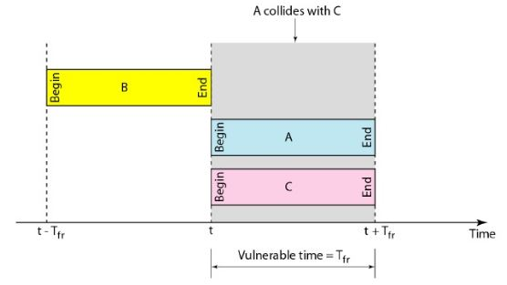
Slotted ALOHA - Vulnerable Time
Fig. 2.2.4 Vulnerable time for the slotted ALOHA

Slide 24
Slotted ALOHA - Disadvantages
The main disadvantage of slotted ALOHA is idle time slots
Another disadvantage is need for clock synchronization

Slide 25
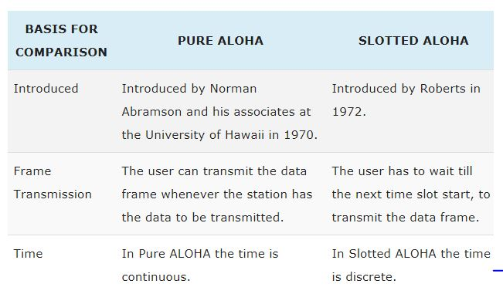
Pure ALOHA Vs Slotted ALOHA

Slide 26

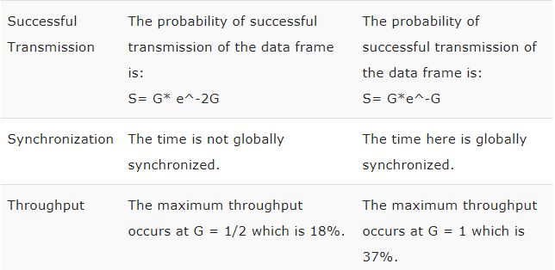
Pure ALOHA Vs Slotted ALOHA

Slide 27
CARRIER SENSE MULTIPLE ACCESS (CSMA)
CSMA protocol was developed to overcome the problem found in ALOHA i.e. to minimize the chances of collision, so as to improve the performance.
CSMA protocol is based on the principle of ‘carrier sense’.
The chances of collision can be reduce to great extent if a station senses the channel before trying to use it.
Although CSMA can reduce the possibility of collision, but it cannot eliminate it completely.
The chances of collision still exist because of propagation delay.

Slide 28
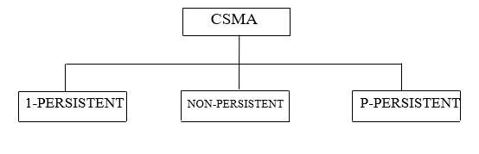
Different Types of CSMA protocols
There are three different types of CSMA protocols :-
(i) 1-Persistent CSMA
(ii) Non-Persistent CSMA
(iii) P-Persistent CSMA

Slide 29

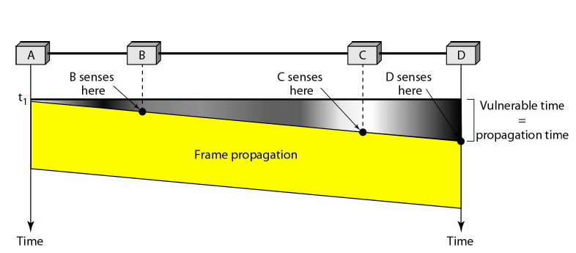

Slide 30
(i) 1-Persistent CSMA
In this method, station that wants to transmit data continuously sense the Channel to check whether the channel is idle or busy.
If the channel is busy , the station waits until it becomes idle.
When the station detects an idle channel, it immediately transmits the frame with probability 1. Hence it is called 1-persistent CSMA.
This method has the highest chance of collision because two or more station may find channel to be idle at the same time and transmit their frames.
When the collision occurs, the stations wait a random amount of time and start all over again.

Slide 31
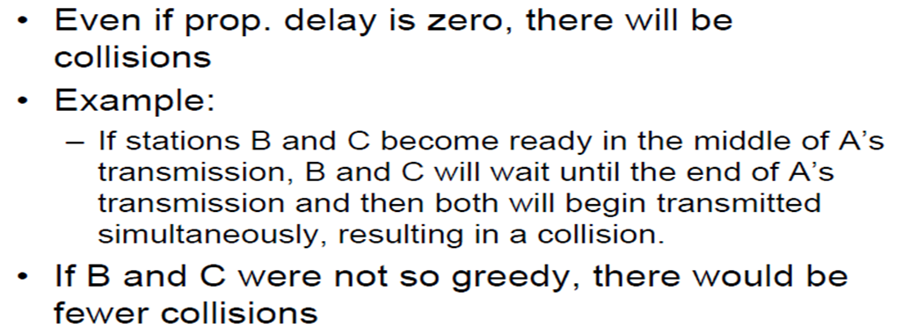
1-Persistent CSMA (cont..)

Slide 32
Drawback of 1-persistent
The propagation delay time greatly affects this protocol. Let us suppose, just after the station 1 begins its transmission, station 2 also become ready to send its data and sense the channel. If the station 1 signal has not yet reached station 2, station 2 will sense the channel to be idle and will begin its transmission. This will result in collision.
Even if propagation delay time is zero, collision will still occur. If two stations become ready in the middle of third station’s transmission both stations will wait until the transmission of first station ends and both will begin their transmission exactly simultaneously. This will also result in collision.
SENSES & TRANSMIT
COUNTINOUSLY SENSES
CHANNEL?
BUSY
TIME
IDLE CHANNEL
IDLE
BUSY CHANNEL
STATION CAN TRANSMIT

Slide 33
(ii) Non –persistent CSMA
A station that has a frame to send senses the channel.
If the channel is idle, it sense immediately.
If the channel is busy, it waits a random amount of time and then senses the channel again.
In non-persistent CSMA the station does not continuously sense the channel for purpose of capturing it when it defects the end of precious transmission .

Slide 34
Advantages and Disadvantages of Non-persistent Method
Advantages:
It reduces the chances of collision because the stations wait a random amount of time. It is unlikely that two or more stations
Will wait for same amount of time and will retransmit at the same time.
Disadvantages
It reduces the efficiency of network because the channel remains idle when there may be station with frames to send.
This is due to the fact that the stations wait a random amount of time after the collision.

Slide 35
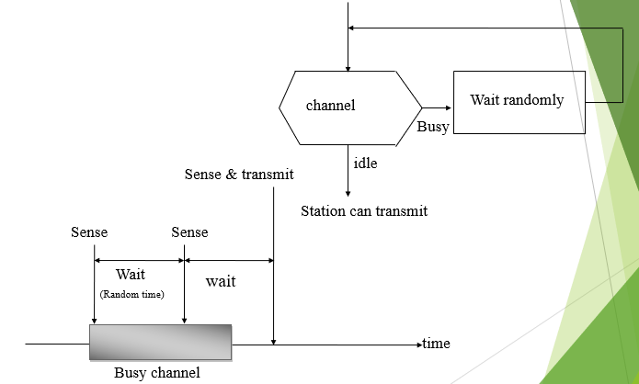

Slide 36
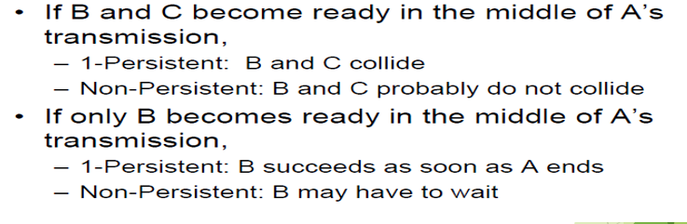
Trade Off between 1 persistent and Non persistent Method

Slide 37
Performance comparison of Non persistent and 1 persistent
Performance of 1 persistent
1-persistent stations are selfish
If two or more stations becomes ready at the same time, collision guaranteed
Performance of non persistent:
Random delays reduces probability of collisions because two stations with data to be transmitted will wait for different amount of times.
Bandwidth is wasted if waiting time (backoff) is large because medium will remain idle following end of transmission even if one or more stations have frames to send

Slide 38
(iii) p-persistent CSMA
This method is used when channel has time slots such that the time slot duration is equal to or greater than the maximum propagation delay time.
Whenever a station becomes ready to send the channel.
If channel is busy, station waits until next slot.
If the channel is idle, it transmits with a probability p.
With the probability q=1-p, the station then waits for the beginning of the next time slot.
If the next slot is also idle, it either transmits or wait again with probabilities p and q.
This process is repeated till either frame has been transmitted or another station has begun transmitting.
In case of the transmission by another station, the station act as though a collision has occurred and it waits a random amount of time and starts again.

Slide 39
Advantages of p-persistent
It reduce the chances of collision and improve the efficiency of the network.
p-persistent CSMA protocol
1. If the medium is idle, transmit with probability p, and delay for one time unit with probability (1 - p) (time unit = length of propagation delay) .
2. If the medium is busy, continue to listen until medium becomes idle, then go to Step 1 .
3. If transmission is delayed by one time unit, continue with Step 1

Slide 40
PROBABLITIY OUTCOME DOES NOT ALLOW
TRANSMISSION
TRANSMIT
COUNTINOUSLY SENSES
Time slot
Time slot
Time slot
TIME
CHANNEL?
BUSY
IDLE
IDLE
>P
PROBABLITY OUTCOME?
CHANNEL?
WAIT A SLOT
BUSY
<_P
Acts as though collision has occurred & start again
STATION CAN START

Slide 41
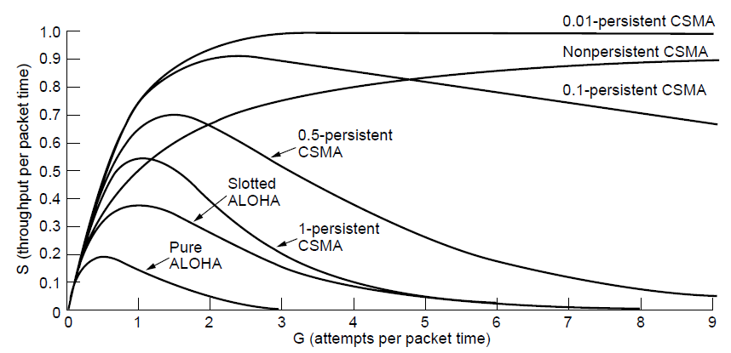
Persistent and Nonpersistent CSMA
Comparison of the channel utilization versus load for various random access protocols.

Slide 42
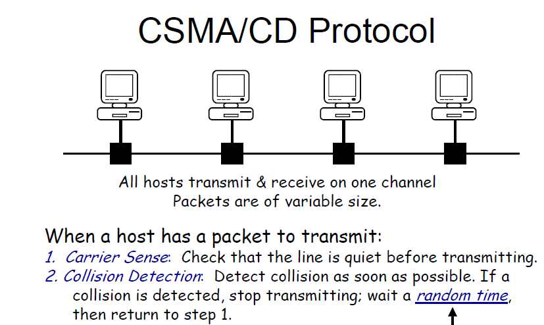

Slide 43
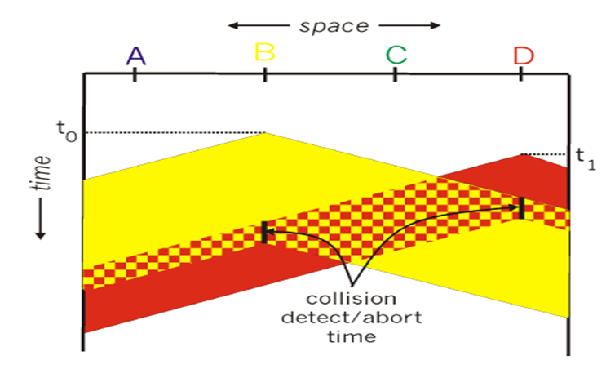
CDMA/CD collision detection
It’s an analog process.
The station's hardware must listen to the channel while it is transmitting.
If the signal it reads back is different from the signal it is pulling out, it knows that a collision is occurring.
The implications are that a received signal must not be tiny compared to the transmitted signal (which is difficult for wireless as received signals may be 1,000,000 times weaker than transmitted signals)
And the modulation must be chosen to allow collisions to be detected (e.g. a collision of two 0 volt signals may well be impossible to detect.).

Slide 44
CDMA/CD collision detection
CSMA/CD, as well as many other LAN protocols, uses the conceptual model as shown in next figure
At the point marked t₀, a station has finished transmitting its frame.
Any other station having a frame to send may now attempt to do so.
If two or more stations decide to transmit simultaneously, there will be a collision.
If a station detects a collision, it aborts its transmission, waits a random period of time, and then tries again (assuming that no other station has started transmitting in the meantime).
Therefore our model for CSMA/CD will consist of alternating contention and transmission periods, with the idle periods occurring when all stations are quiet (e.g for lack of work)

Slide 45
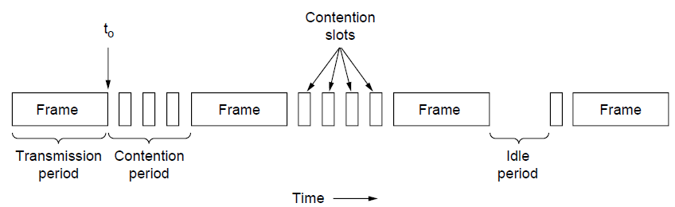
CSMA with Collision Detection
CSMA/CD can be in one of three states: contention, transmission, or idle.

Slide 46
CDMA/CD collision detection
The minimum time to detect the collision is just the time it takes the signal to propagate from one station to the other.
In the worst case, a station cannot be sure that it has seized the channel until it has transmitted for 2 τ without hearing a collision.
So, CSMA/CD contention can be considered as a slotted ALOHA system with a slot width of 2 τ.
The difference between CSMA/CD compared to slotted ALOHA is that slots in which only one station transmits (i.e. in which the channel is seized) are followed by the rest of a frame.
This difference will greatly improve performance if the frame time is much longer that the propagation time.

Slide 47
Collision Free Protocols
Collision adversely affect the system performance, especially when the bandwidth is large, such as when the cable is long (large τ) and the frames are short.
Collisions reduces bandwidth and also make the time to send a frame variable, which is not a good fit for real time traffic such as voice over IP.
CSMA/CD is also not universally applicable.
For collision free protocols that resolve the contention for the channel without any collisions at all not even during the contention period some assumptions are made.
Assumption: there are exactly N stations, each programmed with a unique address from 0 to N-1
It does not matter that some stations may be inactive part of the time.

Slide 48
Collision-Free Protocols: A Bit Map Protocol
In this station j may announce that it has a frame to send by inserting a 1 bit into slot j.
After all N slots have passed by, each station has complete knowledge of which stations wish to transmit.
At that point they begin transmitting frames in numerical order as shown in next figure.
Since everyone agrees on who goes next, there will never be any collision.
After the last ready station has transmitted its frame, an event all stations can easily monitor, another N bit contention period is begun.
If a station becomes ready just after its bit slot has passed by, it is out of luck and must remain silent until every station has had a chance and bit map has come around again.
This type of protocols, in which desire to transmit is broadcast before the actual transmission are called Reservation Protocols as they reserve channel ownership in advance and prevent collision.

Slide 49
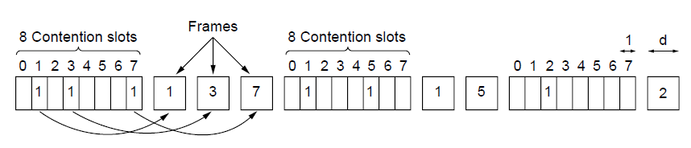
Collision-Free Protocols: A Bit Map Protocol
The basic bit-map protocol.

Slide 50
Collision-Free Protocols : Token Passing
It lets every station transmit a frame in turn in predefined order.
It pass a small message called a token from one station to the next in the same predefined order.
Token represents the permission to send.
If a station has a frame queued for transmission when it receives the token, it can send that frame before it passes the token to the next station.
If it has no queued frame, it simply passes the token.
In token ring protocol, the topology of the network is used to define the order in which station send.
The stations are connected one to the next in a single ring.
Passing the token to the next station then simply consists of receiving the token in from one direction and transmitting it out in the other direction as shown in next figure.

Slide 51
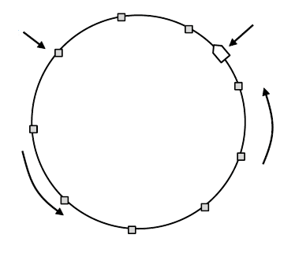
Collision-Free Protocols : Token Passing
Token
Station
Frames are also transmitted in the direction of the token.
This way they will circulate around the ring and reach whichever station is the destination.
To stop the frame circulating indefinitely, some stations needs to remove it from the ring.
This station may be either the originating the frame or the recipient of the frame.
Direction of
transmission
Token ring

Slide 52
Comparison of Token Ring and Bit Map Protocol
Though the contention slots and frames of one cycle are intermingled the performance of both the protocols are similar
After sending a frame, each station must wait for all N stations (including itself) to send the token to their neighbours and the other N-1 stations to send a frame, if they have one.
Difference is that since all positions in the cycle are equivalent, there is no bias for low or high numbered stations.
Each token does not need to propagate to all stations before the protocol advances to the next step.
Problem with these two protocols is that overhead is 1 bit per station, so it does not scale well to networks with thousands of stations.

Slide 53
Binary Countdown Protocol
A station wanting to use the channel now broadcasts the address as a binary bit string, starting with the high order bit.
All addresses are assumed to be the same length.
The bits in each address position from different stations are BOOLEAN ORed together by the channel when they are sent at the same time.
It implicitly assumes that the transmission delays are negligible so that all stations see asserted bits essentially instantaneously.
As soon as a station sees that a high order bit position that is 0 in its address has been overwritten with a 1, it gives up.

Slide 54
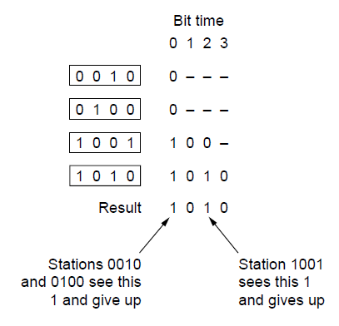
Binary Countdown
If stations 0010, 0100,1001 and 1010 are all trying to get the channel, in the 1st bit time the station transmit 0,0,1 and 1respectively.
These are ORed together to form a 1.
Stations 0010, 0100 see the 1 and know that a higher numbered station is competing for the channel, so they give up for the current round.
Stations 1001 and 1010 continue.
The next bit is 0, both stations continue.
The next bit is 1, so station 1001 gives up.
1010 is the winner station as it has highest address.
The binary countdown protocol. A dash indicates silence.

Slide 55
Contention vs. Collision-Free
• Contention better under low load. Why?
• Collision-free better under high load. Why?
• Hybrid: limited contention protocols
• Instead of symmetric contention, asymmetric
• Divide into groups. Each group contents for same slot.
• How to assign to slots?
– 1 per slot, then collision free (Binary Countdown)
– All in same slot, then contention (CSMA/CD)

Slide 56
Limited contention protocols:
Adaptive tree walk protocol
Trick: dynamic partition the stations into groups and limit the contention for each slot.
under light load, every one tries for each slot like ALOHA
under heavy load, only a small group can try for each slot
how do we do it
treat stations as the leaves of a binary tree.
first slot, all stations (under the root node) can try to get the slot.
if no conflict, repeat.
if conflict, use depth first search to traverse the tree, only nodes of a sub-tree get to try for the next slot.

Slide 57
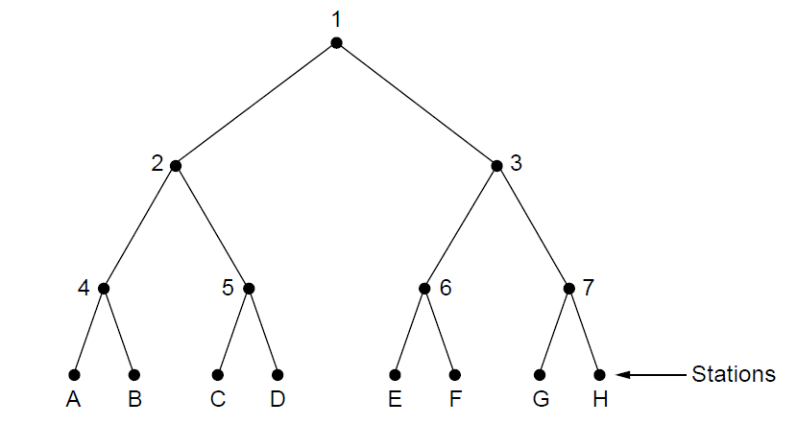
The Adaptive Tree Walk Protocol
The tree for eight stations

Slide 58
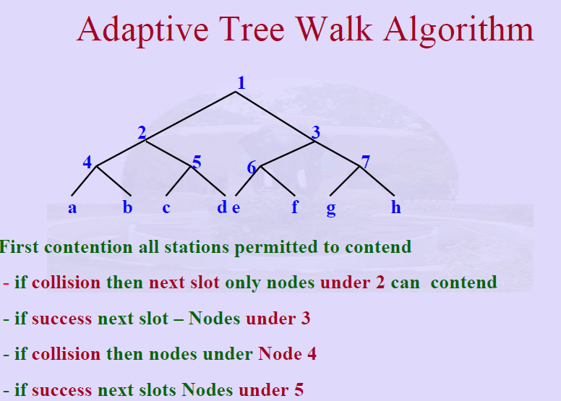

Slide 59
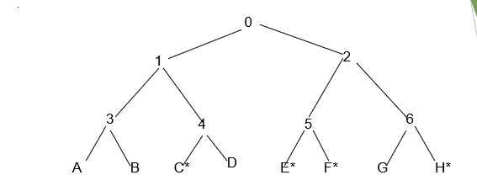
Example The Adaptive Tree Walk Protocol:
Slot 0: C*, E*, F*, H* (all nodes under node 0 can try), conflict
slot 1: C* (all nodes under node 1 can try), C sends
slot 2: E*, F*, H*(all nodes under node 2 can try), conflict
slot 3: E*, F* (all nodes under node 5 can try), conflict
slot 4: E* (all nodes under E can try), E sends
slot 5: F* (all nodes under F can try), F sends
slot 6: H* (all nodes under node 6 can try), H sends.

Slide 60
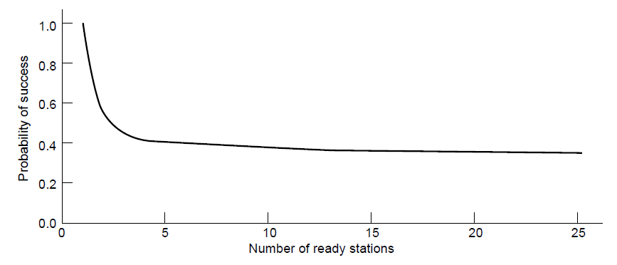
Limited-Contention Protocols
Acquisition probability for a symmetric contention channel.

Slide 61
WIRELESS LAN PROTOCOLS

Slide 62
INTRODUCTION
System of laptop computers that communicate by radio can be regarded as a wireless LAN
It is an example of broadcast channel
A common configuration of wireless LAN is an office building with APs (Access Point), which are wired using fiber or copper strategically placed around the building
These APs provide connectivity to the stations that talk to them

Slide 63
INTRODUCTION
Wireless systems cannot detect a collision while its occurring
Moreover, in wired LANs one station sends a frame and all other stations receive it, which does not happen in wireless LAN causing complications
In wireless LAN, we make an assumption that each radio transmitter has fixed range, represented by a circular coverage region which another station can sense and send or receive frames

Slide 64
CSMA FOR WIRELESS LAN
We might try to use CSMA for wireless LAN; i.e. listen for other transmissions and send only if no one else is doing so
But interference at receiver may create problem for reception of frame
Consider fig 4.1a where four wireless stations are trying to connect to each other

Slide 65
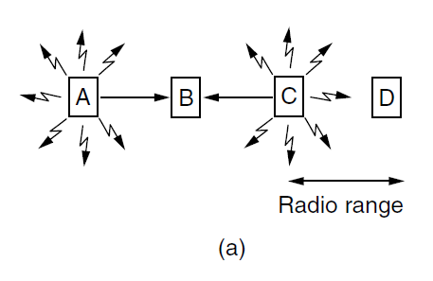
CSMA FOR WIRELESS LAN
The radio range is such that, A and B are within each other’s range and can interfere with each other
C can also interfere with B and D, but not A
Fig 4.1

Slide 66
CSMA FOR WIRELESS LAN - HIDDEN TERMINAL ISSUE
Case I: Consider A and C are transmitting to B as seen in fig 4.1a
If A sends and C immediately senses the medium, it will not hear A because it is out of range
C will falsely conclude that it can transmit to B, and at receiving station B, interference occurs

Slide 67
CSMA FOR WIRELESS LAN - HIDDEN TERMINAL ISSUE
Thus collisions garble the signal and destroy both the frames
This issue of a station not being able to detect a potential competitor for the medium because it is far away is known as hidden terminal problem

Slide 68
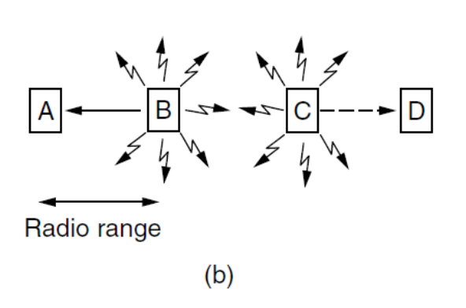
CSMA FOR WIRELESS LAN - EXPOSED TERMINAL ISSUE
Case II: Consider B is transmitting to A and C wants to transmit to D at the same time as seen in fig 4.1b
If C senses a medium, it will falsely conclude that it may not send to D (dashed line)
Fig 4.1

Slide 69
CSMA FOR WIRELESS LAN - EXPOSED TERMINAL ISSUE
It will cause bad transmission between zone B and C only, where neither of intended receivers is located
This causes a waste of bandwidth
This is known as exposed terminal problem

Slide 70
MACA PROTOCOL FOR WIRELESS LAN
MACA is known as Multiple Access with Collision Avoidance
Basic idea for this protocol is that sender stimulate the receiver into outputting a short frame, so stations nearby can detect this transmission
This avoids the issue of garbling the signal at the reception

Slide 71
MACA PROTOCOL FOR WIRELESS LAN
As seen in fig 4.2a, station A wants to send a frame to station B
A starts by sending a RTS (Request to Send) frame to B
RTS frame is of 30 bytes and contains length of data frame that will follow
Then B replies with Clear to Send (CTS) frame as seen in fig 4.2b, and A starts to transmit

Slide 72
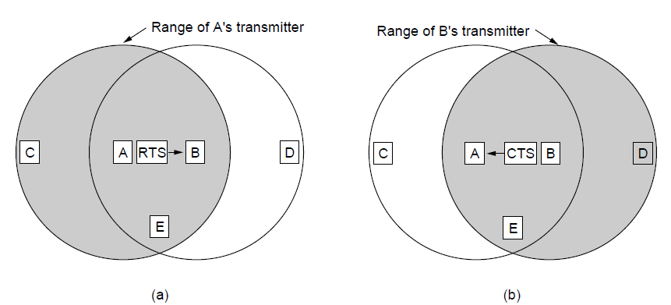
MACA PROTOCOL FOR WIRELESS LAN
Fig 4.2

Slide 73
MACA PROTOCOL FOR WIRELESS LAN
Consider the stations overhearing either of these frames:
Any station hearing RTS is close to A and must be silent long enough for CTS to be transmitted back without conflict
Any station hearing CTS is close to B and must be silent for upcoming data transmission, whose length can be known by examining CTS frame

Slide 74
MACA PROTOCOL FOR WIRELESS LAN
In fig 4.2, C is within range of A but not within range of B, thus it will hear RTS from A only
Similarly, D is in range of B but not A, thus it will hear CTS from B only
Hearing CTS, D comes to know B is about to receive a frame and it defers sending anything until that frame is expected to be finished

Slide 75
MACA PROTOCOL FOR WIRELESS LAN - ISSUES
Despite these precautions, collisions can still occur:
B and C can both send RTS at the same time, which will collide and get lost
An unsuccessful transmitter can fail to hear CTS within its range

